Slide 1
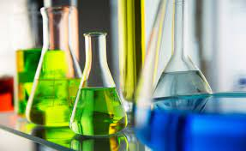
ORGANIC CHEMISTRY II
Lecturer Raghad Aldoghachi

Slide 2
Chemistry Laboratory Safety Rules
Always Follow the Instructions.
Do Not Pipette by Mouth - Ever​.
Read the Chemical Safety Information. A Material Safety Data Sheet (MSDS) should be available for every chemical you use in the lab.
Don't Taste or Sniff Chemicals
Dress Appropriately (include a lab coat, safety goggles and gloves).

Slide 3
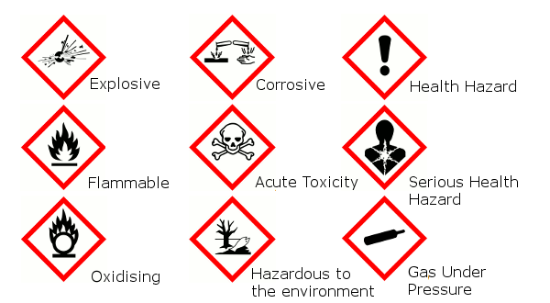
Hazard symbols

Slide 4
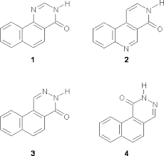
Organic chemistry: Organic chemistry is the scientific study of the structure, properties, composition, reactions, and synthesis of organic compounds (molecules composed of carbon, hydrogen, and may contain any number of other elements like nitrogen,
oxygen and halogens).

Slide 5
Distillation
Is a method of separating mixture based on the differences in the boiling points of the components of the mixture.
Distillation=Evaporations + condensation

Slide 6
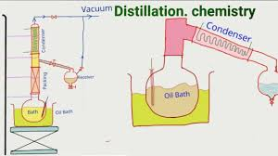
Separation and purification of liquid organic matters
This method depends on the evaporation of liquid by heating and then condensation of steam by cooling, and depending on the type of impurities in the liquid to be distilled.

Slide 7
Types of Distillations Techniques
1- Simple distillation
2-Fractional distillation
3-Vacuum distillation
4-Steam distillation

Slide 8
Simple Distillation
is a procedure used when the boiling point of two liquids are significantly different from each other or to separate liquids from solids or nonvolatile compounds.
Example: separating saltwater to create pure water and salt.
❖ The boiling point of an impure liquid is higher than the boiling point of a pure liquid under any pressure.
❖ (Boiling chips) regulates the boiling process.

Slide 9
Simple Distillation

Slide 10
Fractional Distillation
is used when the boiling points of the components of a mixture are close each other. Generally the component parts have boiling points that differ by less than (25-35)°C from each other atmosphere.
Example: Benzene 80 C ͦ C6H6
Toluene 111 C ͦ C7H8
❖ In this distillation used Fractionating column

Slide 11
Fractional Distillation

Slide 12
Vacuum Distillation
is used to separate components that have high boiling point and is distillation performed under reduced pressure, which allows the purification of compounds not readily distilled at ambient pressures or simply to save time or energy. This technique separates compounds based on differences in boiling points.
Example: Aniline C6H7N boiling point 184 C ͦ

Slide 13
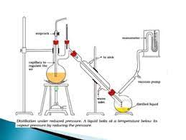
Vacuum Distillation

Slide 14
Steam Distillation
is used to separate heat sensitive components and is a special type of distillation for temperature sensitive materials like natural aromatic compounds.
Used to purify natural vegetable oils.
Used to separate essential its form plants and flowers.
Example: Isolation of limonene from orange peel.

Slide 15
Steam Distillation

Slide 16
Reflux
Reflex is a type of distillation technique involving the condensation of vapour and return of this condensate to the system from which it originated.
❖ Condenser be vertical.
❖ Keep the amount of the solvent evaporation.

Slide 17
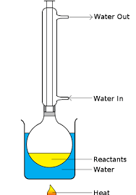
Reflux

